Slide 1
College Application Deadlines
College Prep
Mr. Gordon
jgordon@bisdtx.org

Slide 2
Upcoming Events
hi

Slide 3
College Application Deadlines
There are four main college application deadlines.
Early Action and Regular Decision are the two most common.
1.Early Action (also called Priority Decision)
2.Regular Decision
3.Early Decision
4.Rolling Admission
And I do not know why they all sound the same
hi

Slide 4
College Application Deadlines
1.Early Action or Priority Decision Deadline- if you turn in your application by this date, you receive an admission decision early. Sometimes the application fee is waived.
UT Austin’s Early Action Deadline is November 1st. If you apply by this day, you will receive your admission decision by mid-February.
hi

Slide 5
College Application Deadlines
2. Regular Decision Deadline- last day to apply.
UT Austin’s Regular Decision Deadline is December 1st. If you apply by this day, you will receive your admission decision by late Spring.
Both early action and regular decision are non-binding, meaning if you get accepted you are not obligated to attend there.
hi

Slide 6
College Application Deadlines
Applying early is helpful for a few reasons:
Less waiting to hear back = less stress.
Sometimes application fees are waived.
Many other university deadlines are March 1st or April 1st, so hearing back early allows you to decide if you need to apply to other universities.
(I recommend applying to 3-5 universities.)
hi

Slide 7
College Application Deadlines
3. Early Decision Deadline- if you apply by this date and are accepted, you are obligated to attend.
This is a binding (obligated to attend) agreement. Early Decision should only be used if this is your first-choice university.
Applying Early Decision can possibly increase your chances of getting accepted since colleges know you are committed.
hi

Slide 8
College Application Deadlines
There are only a few universities in Texas (all private) who use Early Decision, including Rice, Southern Methodist, and Texas Christian University.
Many other universities that use Early Decision are Ivy League schools.
You can still apply to these universities if you don’t choose to apply Early Decision.
hi

Slide 9
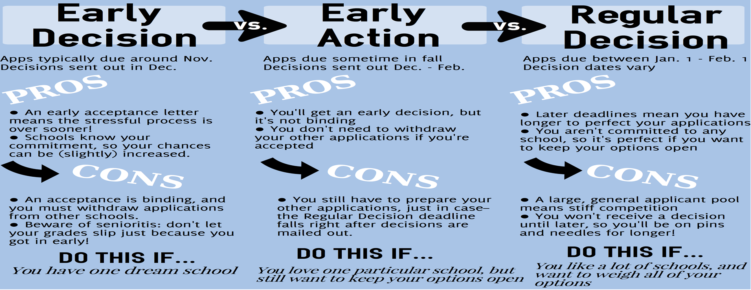
College Application Deadlines
Below is an infographic of the Pros and Cons of each decision.
https://theenrichery.com/2016/08/10/early-decision-early-action/
hi

Slide 10
College Application Deadlines
4. Rolling Admission- universities review applications as they are submitted and accept/ deny students throughout the admission cycle.
This is a non-binding admission decision.
Texas State and Abilene Christian both use rolling admission
(pretty much).
hi

Slide 11
College Prep Assignment
Please answer the following question in the Google Classroom comments section:
What is the date of UT Austin’s Early Action Application Deadline?
hi

